Slide 1
Managing Proficiency Data Management eTools for PT – ePT
Laboratory Data Monitoring Team
International Branch, CDC Atlanta
RTCQI Best Practices Workshop-Western Hemisphere

Slide 2
Agenda
Overview of PT Data Management
Roles and Responsibilities of Stakeholders
Data Flow and Management Overview
Integration with Other Data Management Tools
Live Demonstration of the Data Tool

Slide 3
Overview
Online PT Data Management tools help countries manage PT programs. It reduces the burden of using paper forms, manual evaluation, and reports to reduce turnaround time in providing feedback to participants.
Test Supported:
HIV Diagnoses Testing for serial, parallel, and 3 test algorithms, combo test with syphilis and hepatitis test.
Recency with and without diagnosis testing
VL, EID, COVID
TB XREF, XREF Ultra, Microscopy, and other methods.
Generic one-test algorithm

Slide 4
Stakeholders and Their Roles
PT Manager Responsibilities:
  Program Management: Oversee the creation and operation of the PT program, encompassing all aspects from participant enrollment to PT shipment and evaluation.
  Data Management: Ensure accurate creation and handling of results, maintaining comprehensive records throughout the testing process.
PT Participants' Role:
  System Utilization: Engage with the online system to submit PT responses and access evaluation results efficiently.

Slide 5
Data Flow and Management
Add a flowchart for data flow too…

Slide 6
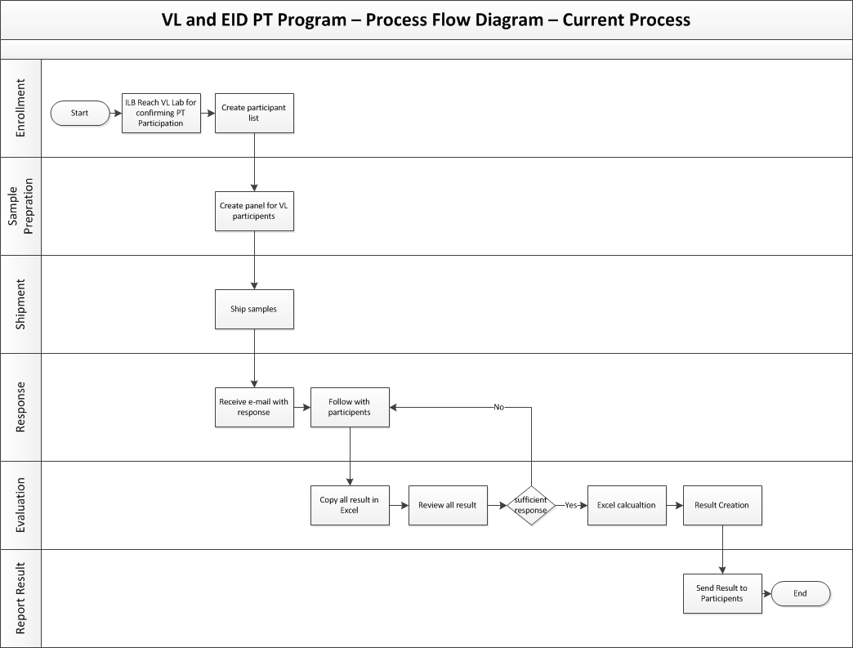
ePT – Implementation - Benefit

Slide 7
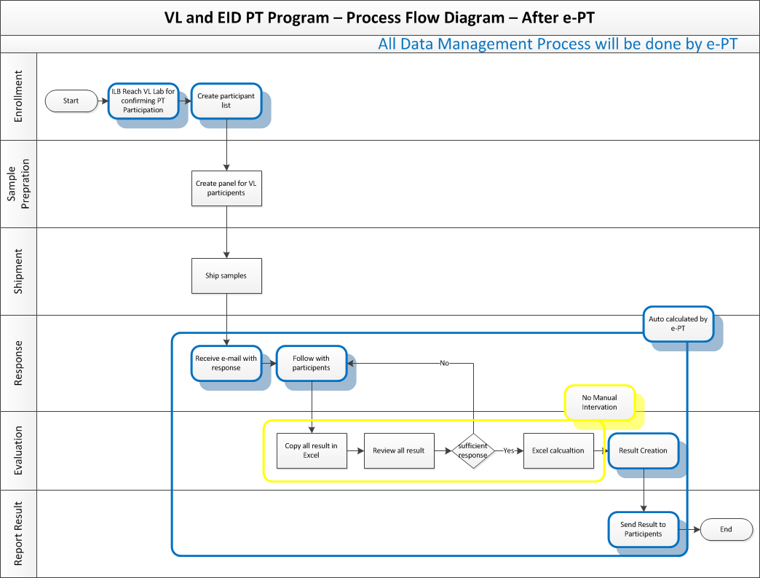
ePT – Implementation - Benefit

Slide 8
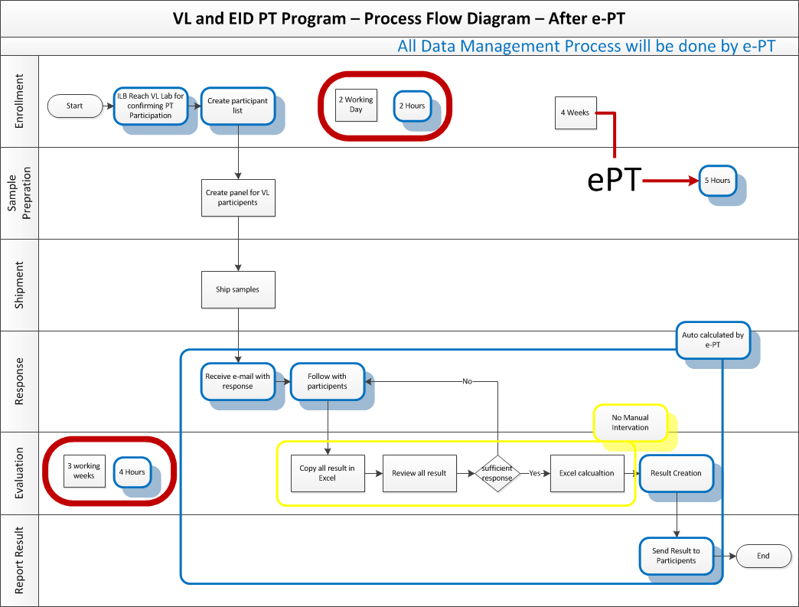
ePT – Implementation - Benefit

Slide 9
Implementation Considerations
Project Management:
  Funding Source: Minimal funding is needed (approximately $200.00) to maintain the cloud server for one year. Alternatively, can utilize in-country MOH/partner’s server.
  Data Manager: Coordinates tasks of enrollment and manages day-to-day operations.
  Country IT Team: Facilitates knowledge transfer to ensure sustainability.
Technical Area:
  Testing Algorithms: Options include 2-test or 3-test systems, combo tests, among others.
  Participants: Configurable for individual or laboratory participation.
  Technical Support: Capable of supporting PT participants with varying technical needs.
  Configuration Needs: Different algorithms require specific configurations.
  Software Flexibility: Supports multiple PTs using the same software platform.
CDC Oversight: Provides guidance and oversight to partners in the implementation process.

Slide 10
Effectiveness and Integration
Efficiency: Streamlines processes to minimize manual effort and time needed for data collection, enhancing operational efficiency.
Accuracy: Guarantees both the timeliness and precision of data collection, ensuring high standards of data quality.
Support for Testers: Equips quality managers with real-time data to effectively foresee training requirements and uphold testing standards.
System Integration: Incorporates tester certifications and proficiency testing seamlessly, reinforcing the framework for comprehensive quality assurance.

Slide 11
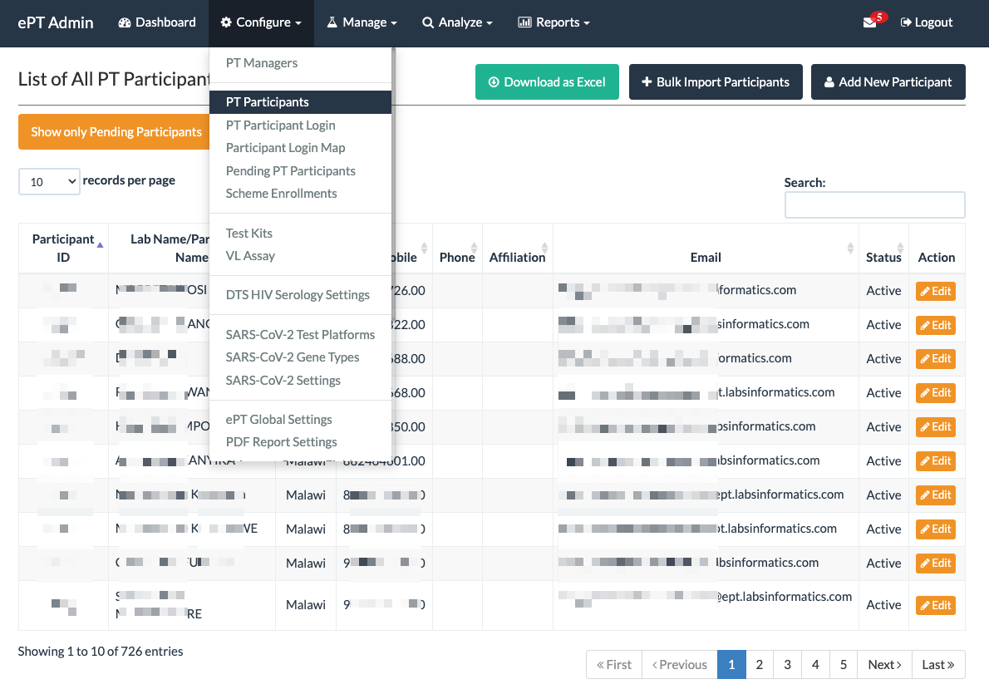
Configuring System
Manage PT Participating Agencies/Individuals
Manage login access
Configure System and Reports
Manage administrative access for e-PT system
Configure Test Kits, Assays etc.

Slide 12
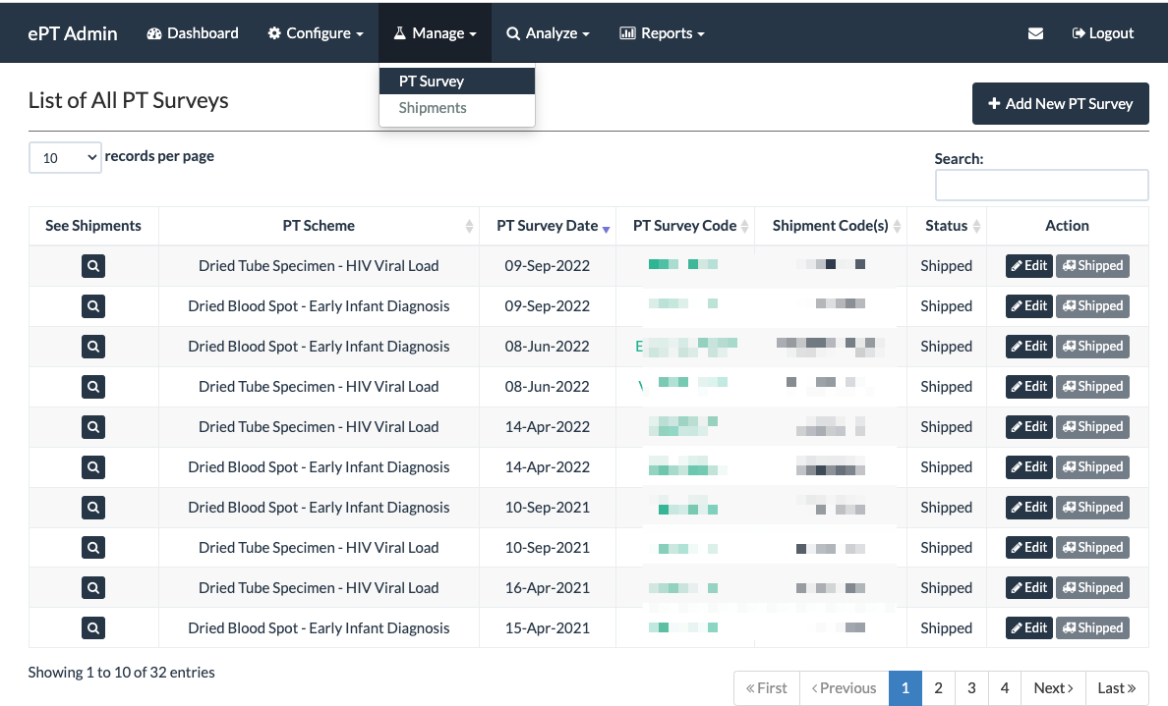
Manage Surveys/Shipments
Manage PT Survey
Manage Testing panel in PT Survey
Manage participants enrollment for a given panel
Add/Modify reference result for a given panel
Ship the panel to participant

Slide 13
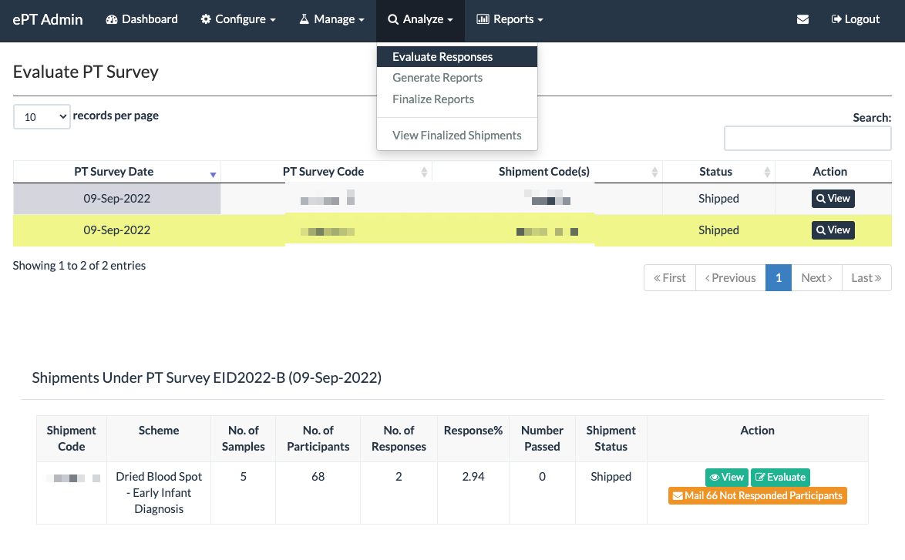
Evaluation and Report Generation
Evaluate participants responses
Reviewing response rate and participant performance
Generate reports for PT participants
View/Export reports for a given shipment
Edit and modify participant responses if needed

Slide 14
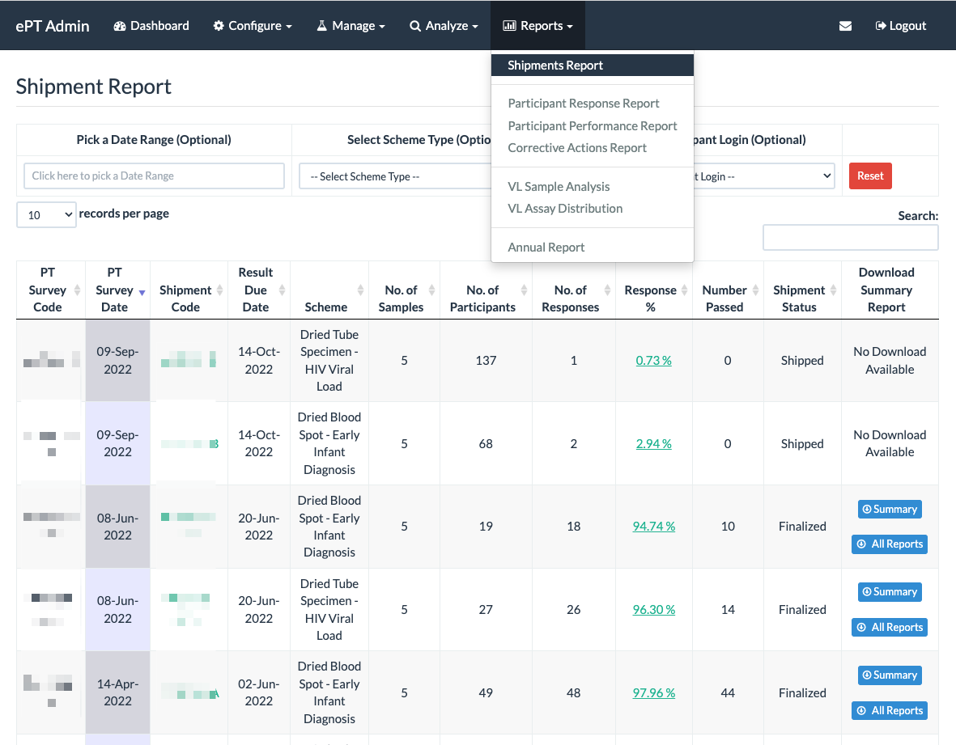
Analysis/Reporting
Participants Performance Reports
Corrective Actions Report
Detailed Shipment Report
Test Kit Usage Report
Export/Download Data for Analysis

Slide 15
Live Demo - Scenario Overview
Location and Partners:
Country: Healthland
District: Medville
eTool – PT data Management:
  Responsibility: The National Reference Laboratory oversees DTS PT program.
  Participent: Participant responds Pt program using online system.
Event Example:
Collaboration: The National Reference Laboratory :
  Add a new PT participant.
  Create new shipment.
  Evaluation and result distribution
Integration Highlights:
  Tester Certification Linkage: Demonstrates how the tool integrates tester certification processes with individual tester certifications, enhancing oversight and quality.
  Proficiency Testing (PT) Linkage: Ensures direct integration of PT results with site audits to maintain testing quality.
  SPIRRT Linkage: Establishes a connection between the testing site and the SPII RT checklist to streamline compliance and reporting.
Demo Objectives:
This demonstration will guide you through the full cycle of PT data management.
Includes a dashboard demonstration tailored to the outlined scenario, highlighting efficient data entry, management, and reporting capabilities.

Slide 16
Ready to Collaborate and Enhance?
Engage:
  Please feel free to ask any questions now provide Feedback:
  Share your thoughts on how we can improve or adapt these tools for better efficiency.
Plan Next Steps:
  We are here to support you every step of the way. Let’s schedule a follow-up to discuss specific implementation strategies.
Stay Connected:
  For further inquiries or additional information, don’t hesitate to contact me.
    Email: app0@cdc.gov
Let's dive deeper into any aspects you're interested. Please visit us at IT Booth.

Slide 17
Thank You

