Slide 1
Enhancing Lab Tester Certification Through Data Tools eTools for Tester Certification
Laboratory Data Monitoring Team
International Branch, CDC Atlanta
RTCQI Best Practices Workshop-Western Hemisphere

Slide 2
Agenda
Overview to Certification Data Management
Roles and Responsibilities of Stakeholders
Data Flow and Management Overview
Integration with Data Management Tools
Live Demonstration of the Data Tool

Slide 3
Overview
Certifications are issued by a single certifying agency within the country.
Certificates are awarded based on scores from both written and practical exams.
Certifications typically expire after 2 years, with renewals contingent on passing a written test within a specified timeframe.
Partners and representatives contribute to the certification process by:
  Recommending testers based on written and practical exam results.
  Reviewing and approving certification requests according to established standards.

Slide 4
Stakeholders and Their Roles
Certifying Agency
  Primary responsibility for issuing and renewing certifications.
Supporting Partners:
  Facilitate training sessions.
  Organize certification testing (both written and practical).
  Compile and submit testing data.
Testers:
  Participate in training.
  Receive reminders about certification expiry.
  Complete online tests for certification renewal.

Slide 5



Data Flow and Management
Certifying Agency
Parmer/MoH/ District/Province
Parmer/MoH/ District/Province
Testers
Testers

Slide 6
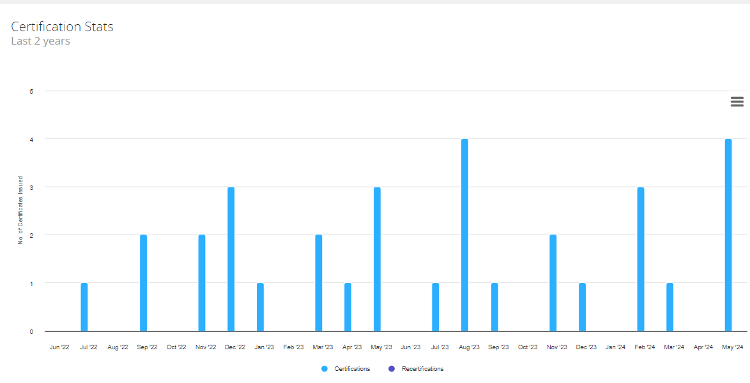
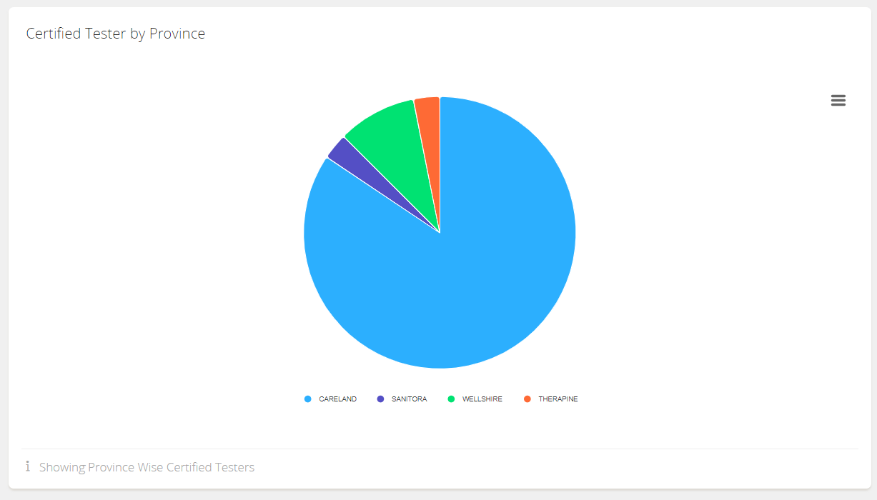
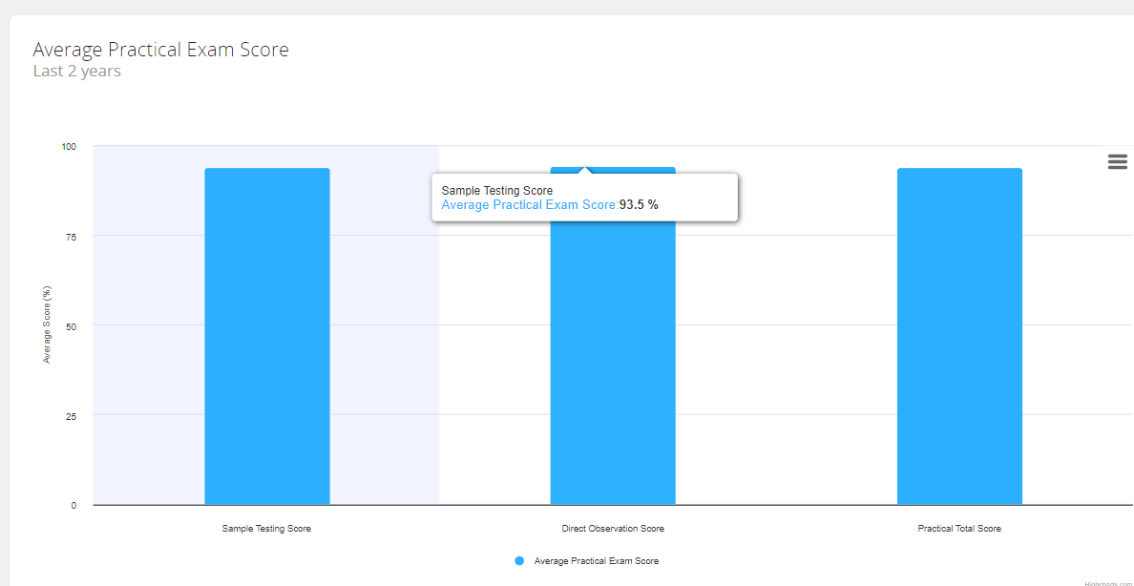
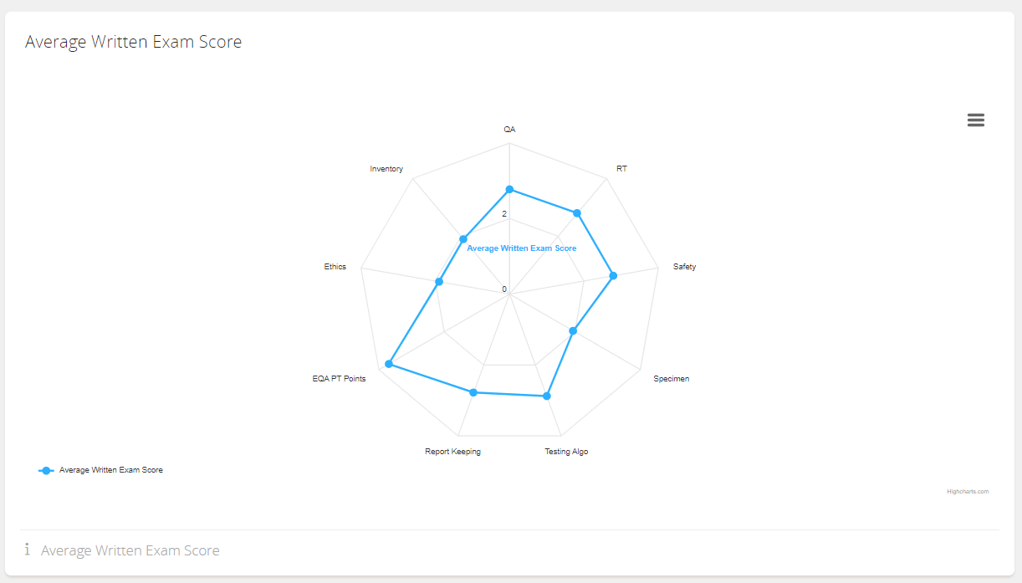
Dashboard

Slide 7
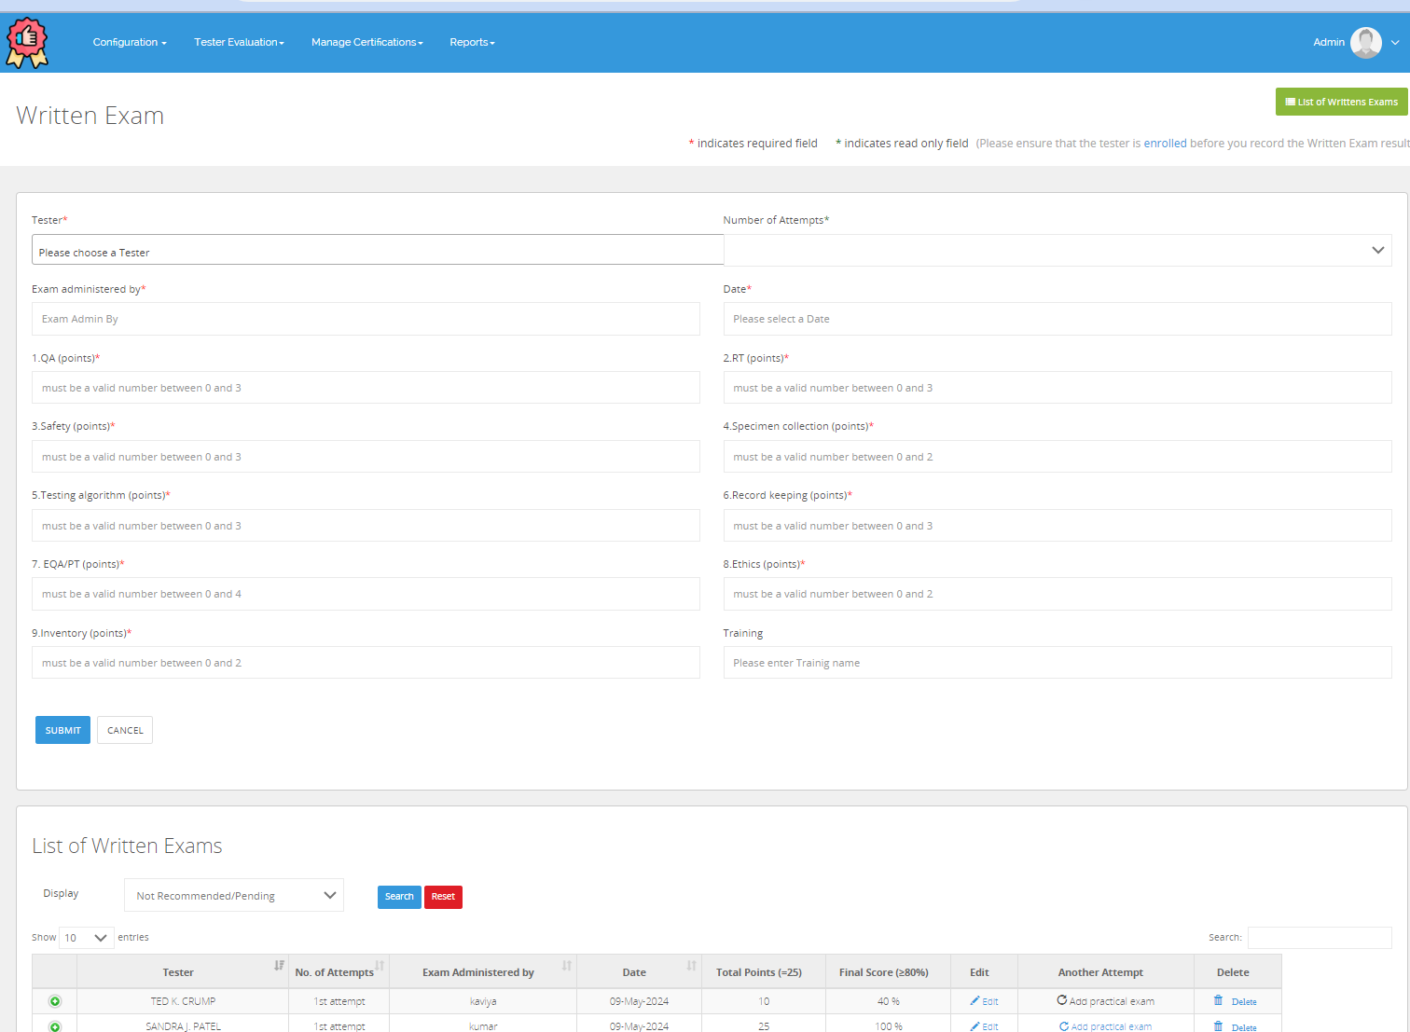
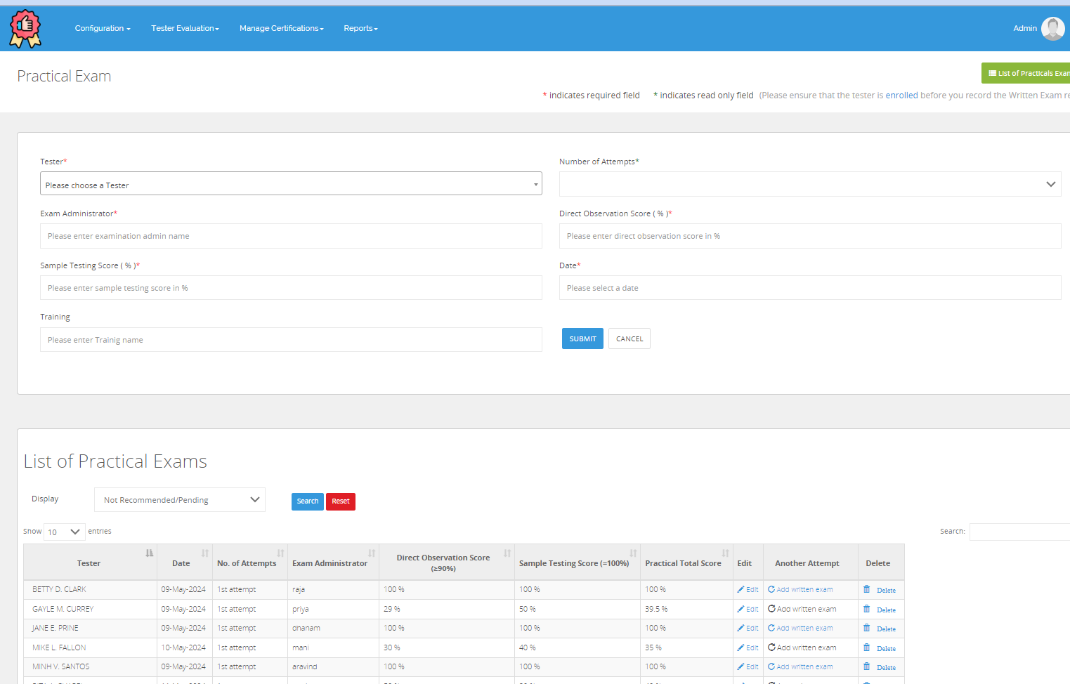
Competency Testing

Slide 8
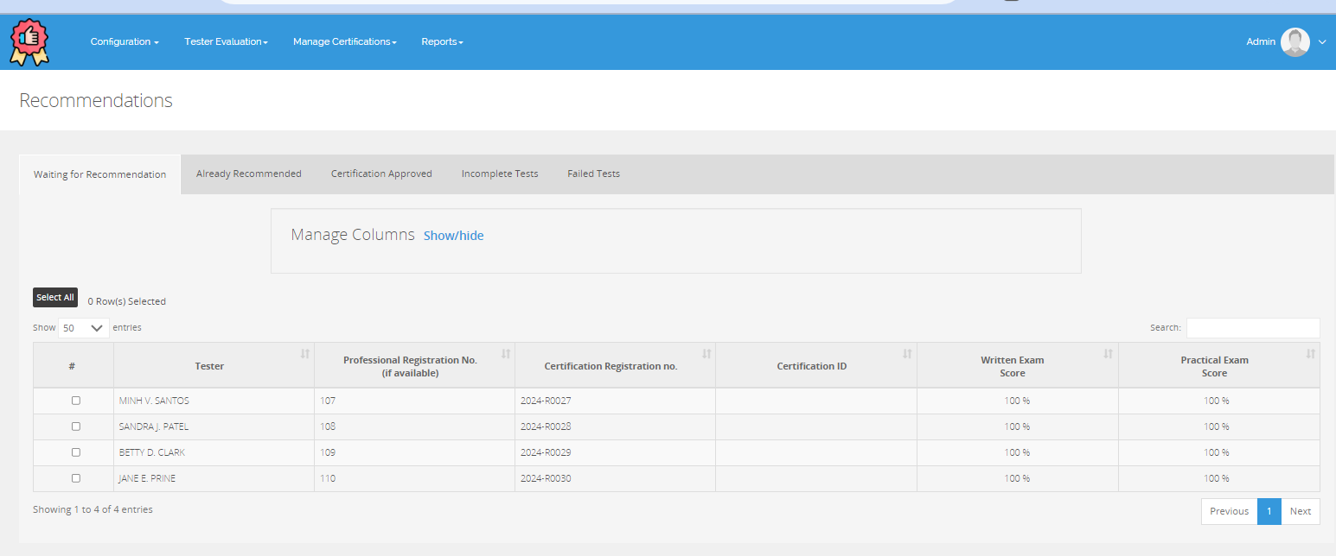
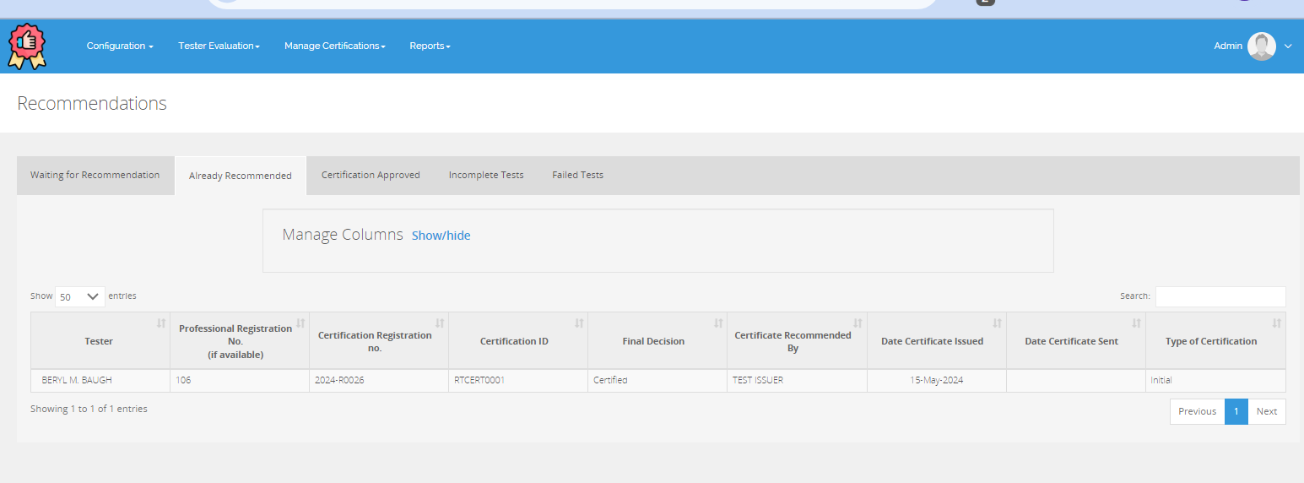
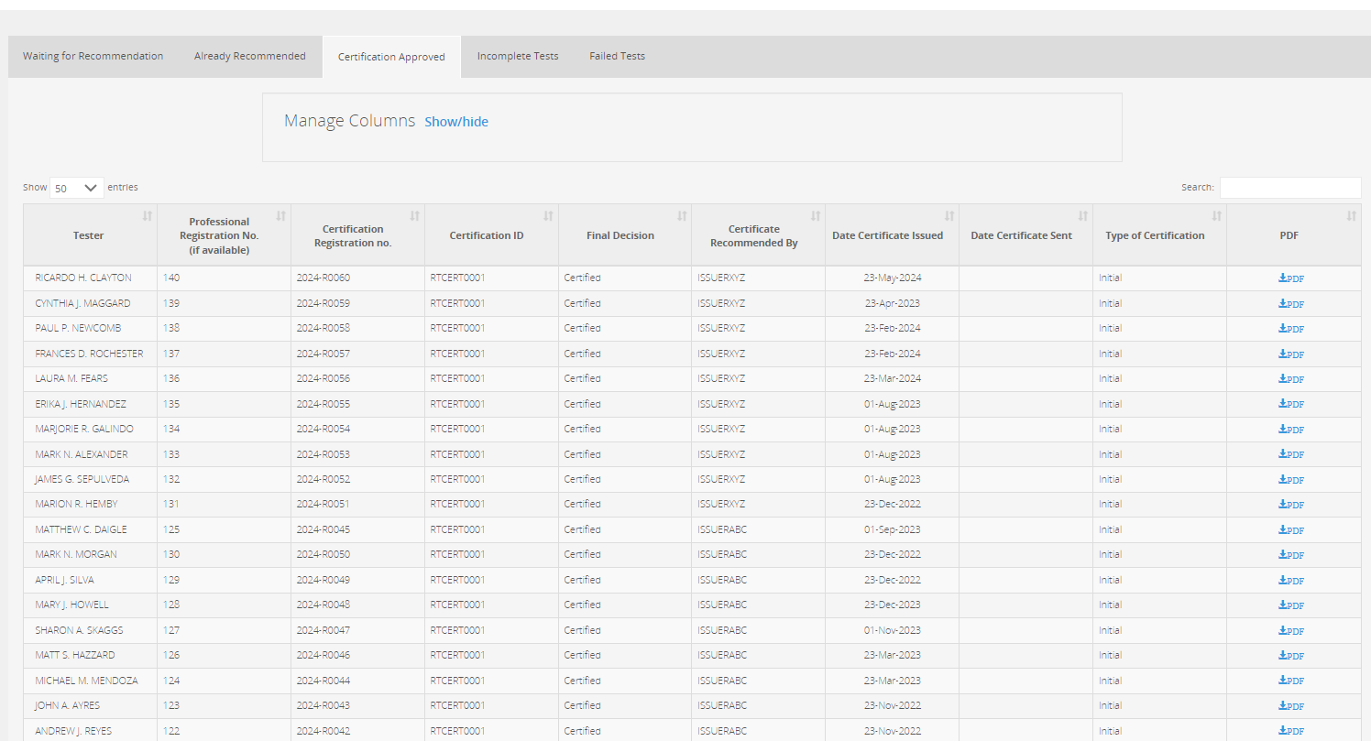
Certification Process

Slide 9
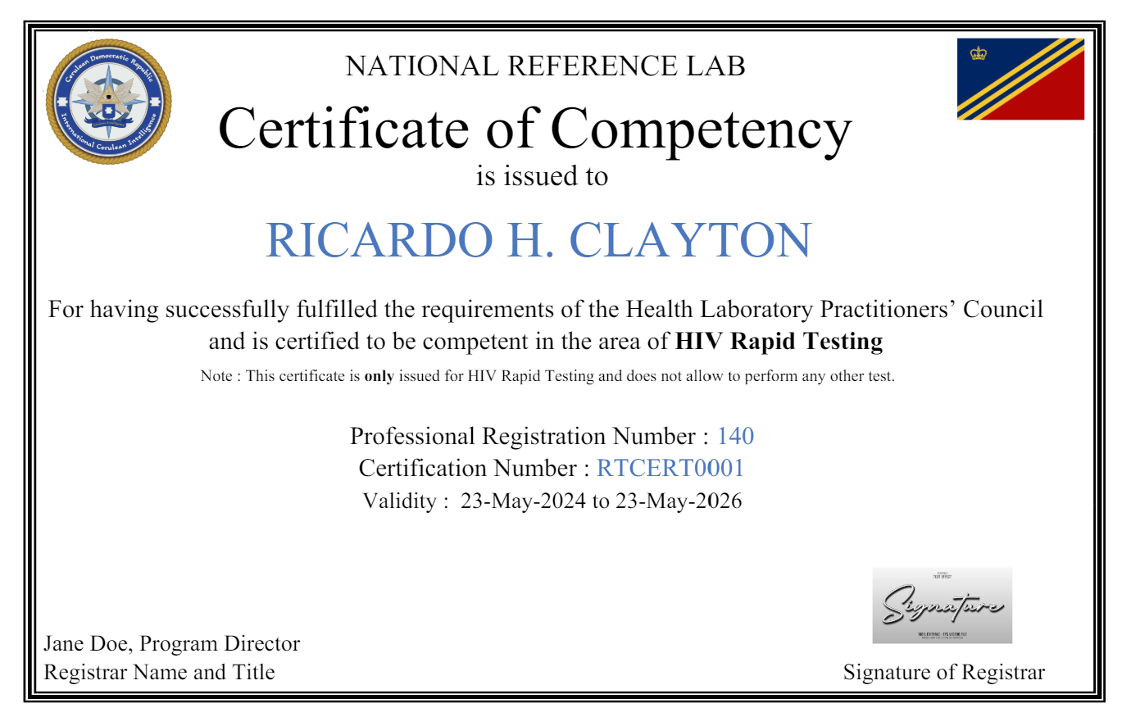
Certification

Slide 10
Effectiveness and Integration
Key Benefits:
  Efficiency: Streamline data management processes, reducing manual effort and time required for tasks.
  Accuracy: Enhance the precision of data collected and reported, minimizing errors in certification tracking and renewal.
  Support for Testers: Improve the provision of timely and relevant information to testers, enhancing their training and certification experience.
Integration Highlights:
  SPIRRT System: Integrates site certification processes with tester certifications, creating a cohesive management system that aligns site needs with tester qualifications.
  Proficiency Testing (PT) Linkage: Connects proficiency test results directly with tester certifications, ensuring that certifications reflect current competencies and compliance with standards.
Reporting Improvements:
  Accurate reports at the district, national, and partner levels, facilitating better decision-making and policy formulation.

Slide 11
Ready to Collaborate and Enhance?
Engage:
  Please feel free to ask any questions now provide feedback
  Share your thoughts on how we can improve or adapt these tools for better efficiency.
Plan Next Steps:
  We are here to support you every step of the way. Let’s schedule a follow-up to discuss specific implementation strategies.
Stay Connected:
  For further inquiries or additional information, don’t hesitate to contact me.
    Email: app0@cdc.gov
Let's dive deeper into any aspects you're interested. Please visit us at IT Booth.

Slide 12
Live Demo -- Scenario Overview
Country: Healthland
District: Medville
Partners: HealthPartners Global
Certification Process:
  The National Accreditation Board is responsible for issuing certificates.
Certification Requirements:
  Successful completion of the practical exam.
  Score above 80 on the written exam.
Event Example:
  Training Event Organized by HealthPartners Global:
    A certification workshop for HIV testers.
    Practical testing sessions to assess hands-on skills.
    Written exams administered both online and on paper to evaluate theoretical knowledge.
Tool Usage:
  HealthPartners Global's Role: Manages event data, ensuring efficient organization and accurate data capture during the event.
  National Accreditation Board's Role: Uses the tool to oversee certification at the national level, ensuring all standards for issuance are met.
  MedSupport Initiative's Role: Utilizes the tool at the district level to manage local certification processes and meet district-specific requirements.
Integration Highlights:
  Link with Site Certification (SPIRRT): Illustrates how the tool connects site-specific certification processes with individual tester certifications, ensuring consistency and compliance.
  Proficiency Testing (PT) Linkage: Demonstrates integration of PT results directly with tester certifications, keeping certification data current and valid.
This demo will walk you through a complete cycle from training registration to certification issuance, showcasing real-time data updates and reporting. demonstration using the scenario outlined, showing practical data entry, management, and reporting functions within the tool across different organizational levels.

Slide 13
Thank You

